Slide 1
Mapping Your Technology Path
How to achieve optimal accounting experiences for clients, practitioners and managers
Flaming Gorge, Utah
Notes:
Introduce webinar.
Mapping Your Technology Path: How to Achieve Optimal Accounting Experiences for Clients, Practitioners and Managers

Slide 2
Gary Boomer
Lyle Ball
Visionary & Strategist
CEO and Co-Founder
Boomer Consulting Inc.
Avii
Notes:
Moderator:
Gary Boomer, is recognized in the accounting profession as the leading authority on technology and firm management. He consults and speaks around the globe on several topics including strategic and technology planning; mindset, skillsets and toolsets for the future; change management and developing a training and learning culture. He also acts as a planning facilitator and coach to some of the accounting profession's top firms. Gary is the creator of The Boomer Technology Circles and the Boomer CIO Circle, through which he helps firms bridge the gap between technology and practice management and prepares technology professionals for a seat at the management table by developing their business and IT acumen. In addition to consulting with hundreds of accounting firms, he has counseled companies such as IBM, Microsoft, Intuit, Wolters Kluwer, Sage, XCM, Expensify and Thomson Reuters on the design and marketing of accounting related software. He continues to consult with many industry technology providers to better serve the needs of the CPA profession and their clients.
Lyle Ball is a Co-Founder and CEO of Avii. For the past 25 years, he has served as a senior executive and serial entrepreneur of high-growth software companies fueled by venture capital firms. Lyle’s operational background helped him envision how accounting firms can optimize their business and use automation to improve productivity, communication and revenue. On a personal note, he and his wife enjoy the wilderness, beaches and extreme outdoor sports. They just welcomed their very first grandchild a year ago in the summer of 2020.

Slide 3
Today you will learn:
The Painful State of Accounting Software
The Accounting Experience ManagementTM Matrix
How to use the matrix to uplift Front, Mid and Back office solutions
How the matrix maps Accounting Experience ManagementTM success
Notes:
Lyle:
Learning objectives:
How to identify the matrix of accounting services, and the way it supports the process of perpetual change management and elevation of technology and services.
How to optimize your understanding and use of the matrix to master success in functions for front, mid and back office solution sets.
How to optimize your use of the matrix and process to maximum Accounting Experience Management success for clients, practitioners and managers, which is your greatest route to business effectiveness and revenue success.

Slide 4
Mapping Your Technology Path
Achieve optimal accounting experiences by:
Balancing the interests of clients, practitioners and managers
Correlating the priorities of front, mid and back office
Staying on top of change management
Notes:
Lyle:
This sounds like a tall hurdle – and inherent in this is the additional challenge that not only must you simultaneously consider the interests of clients, practitioners and managers at all times, you also need to respect and correlate the priorities and interrelation of front, mid and back office technology and applications. In addition to this, change management will be a perpetual process – that’s okay, and in our work with clients we’re hearing and determining that’s a better way to go than to gear up for a massive technology migration as a single event (which even then, would have to be repeated after a number of years).

Slide 5
The Painful State of Accounting Software
Accounting firms have 30-85 mostly disconnected software silos per firm.
Notes:
Lyle:
We refer to this worksheet frequently and will make it available to you as a download at the end of this webinar, but on the screen right now you see a planning tool for Accounting Experience Management that we can best describe as a matrix.
With the Avii team, we designed this graphic and tool as an answer to the million dollar question we hear again and again: “There are so many areas where I want to evolve the technology at our firm…where do I start?”
….and my answer is to start with this page, which is a matrix. We can start by dividing up the tech world into the 25 areas you see here, and by identifying the pain points your firm is experiencing across all audiences and offices (front/mid/back). Then you can creating a totem to identify the BIGGEST problems, and create a vision that outlines how to advance in a way that every step forward builds on the steps you are taking and also prepares the firm to take the future steps over the coming seasons.

Slide 6
The Painful State of Accounting Software
Hairball Architecture results in disjointed workflows & data for clients, practitioners and managers
Notes:
Lyle:
We refer to this worksheet frequently and will make it available to you as a download at the end of this webinar, but on the screen right now you see a planning tool for Accounting Experience Management that we can best describe as a matrix.
With the Avii team, we designed this graphic and tool as an answer to the million dollar question we hear again and again: “There are so many areas where I want to evolve the technology at our firm…where do I start?”
….and my answer is to start with this page, which is a matrix. We can start by dividing up the tech world into the 25 areas you see here, and by identifying the pain points your firm is experiencing across all audiences and offices (front/mid/back). Then you can creating a totem to identify the BIGGEST problems, and create a vision that outlines how to advance in a way that every step forward builds on the steps you are taking and also prepares the firm to take the future steps over the coming seasons.

Slide 7
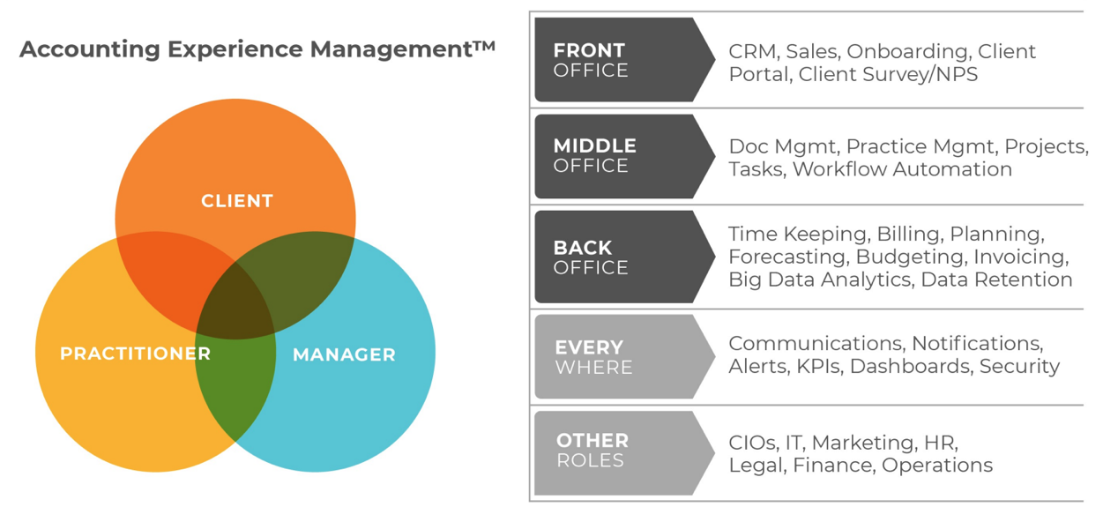
Insert graphic of worksheet expressed as a matrix
Notes:
Lyle:
So here you see the worksheet again, expressed as a matrix. Now it’s important to recognize that for every one of these audiences and functions we’ve identified and defined on the left side of our page, it is vital that we also look at each of them in terms of the impact they have on the audience of your clients, your practitioners and your managers.
This is where, once again, we stress the principle of Accounting Experience Management being the magic and the engine that drives everything – it’s the glue that holds the success of the organization together, which we often refer to in the statement on change management and experience management I make frequently (advance to next slide).

Slide 8
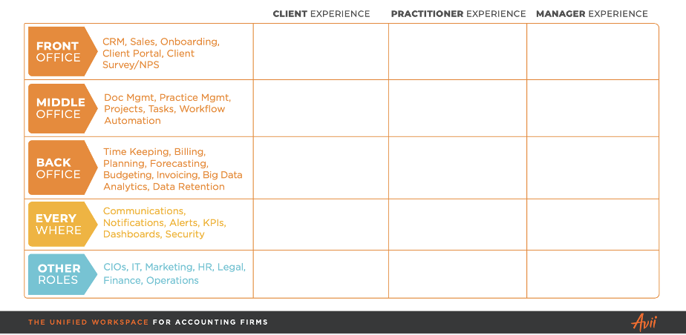
Notes:
Lyle:
We refer to this worksheet frequently and will make it available to you as a download at the end of this webinar, but on the screen right now you see a planning tool for Accounting Experience Management that we can best describe as a matrix.
With the Avii team, we designed this graphic and tool as an answer to the million dollar question we hear again and again: “There are so many areas where I want to evolve the technology at our firm…where do I start?”
….and my answer is to start with this page, which is a matrix. We can start by dividing up the tech world into the 25 areas you see here, and by identifying the pain points your firm is experiencing across all audiences and offices (front/mid/back). Then you can creating a totem to identify the BIGGEST problems, and create a vision that outlines how to advance in a way that every step forward builds on the steps you are taking and also prepares the firm to take the future steps over the coming seasons.

Slide 9
Poll #1
How effective is your firm at actually advancing change management and technology evolution?
Notes:
Very effective
Moderately effective
We have no set plan
What’s change management?
Reminder: ask for comments/specifics in the chat field.

Slide 10
Poll #2
Which part of your accounting software infrastructure (front, mid or back office)
could benefit most from a technology uplift?
Notes:
Front Office
Mid-Office
Back Office
Reminder: ask for comments/specifics in the chat field.

Slide 11
Insert graphic of worksheet expressed as a matrix
Notes:
Lyle:
So here you see the worksheet again, expressed as a matrix. Now it’s important to recognize that for every one of these audiences and functions we’ve identified and defined on the left side of our page, it is vital that we also look at each of them in terms of the impact they have on the audience of your clients, your practitioners and your managers.
This is where, once again, we stress the principle of Accounting Experience Management being the magic and the engine that drives everything – it’s the glue that holds the success of the organization together, which we often refer to in the statement on change management and experience management I make frequently (advance to next slide).

Slide 12
“Change Management is vital, but it is more than what you do.
It’s how you do it, and how it’s perceived, experienced, and measured by all stakeholders.”
Lyle Ball, CEO, Avii
Notes:
Lyle:
This is our mantra. And Knowing this, our vision is to help firms uplift their Accounting Experience Management by allowing them to own, connect, and automate more of their data.
So with this mantra in mind, let’s scroll back to the Accounting worksheet again and talk about how to use it most effectively. On the worksheet, note which areas contain your highest pain points? And which areas are currently best served by whatever solutions you’re using.
If you were to improve your support in this area, how would it impact your Clients? Your Practitioners? Your Managers? And how would it affect the technology and corporate functions within your firm? Now you can prioritize the areas you identify as the highest needs and can begin to address them in sequence.

Slide 13
Poll #3
At your firm, which key audience (clients, practitioners or managers) could benefit the most from an uplift in Experience Management?
Notes:
Clients
Practitioners
Managers
Reminder: ask for comments/specifics in the chat field.

Slide 14
The Painful State of Accounting Software
OUR SOLUTION
Hairball Architecture results in disjointed workflows & data for clients, practitioners and managers
Accounting firms have 30-85 mostly disconnected software silos per firm
Avii replaces apps and unifies third-party workflows & data like a skybridge
Notes:
Lyle:
We refer to this worksheet frequently and will make it available to you as a download at the end of this webinar, but on the screen right now you see a planning tool for Accounting Experience Management that we can best describe as a matrix.
With the Avii team, we designed this graphic and tool as an answer to the million dollar question we hear again and again: “There are so many areas where I want to evolve the technology at our firm…where do I start?”
….and my answer is to start with this page, which is a matrix. We can start by dividing up the tech world into the 25 areas you see here, and by identifying the pain points your firm is experiencing across all audiences and offices (front/mid/back). Then you can creating a totem to identify the BIGGEST problems, and create a vision that outlines how to advance in a way that every step forward builds on the steps you are taking and also prepares the firm to take the future steps over the coming seasons.

Slide 15
The Top 6 Accounting Workflows Where Automation Plays Best
for Client, Practitioner and Manager Experiences
Bryce Canyon, Utah
Notes:
Lyle:
In our most recent prior webinar, The Top 6 Accounting Workflows Where Automation Plays Best, we walk through each of our technology solution sets in detail, and we also talk about the ways in which Avii uniquely allows you to create an interconnected “sky bridge” from the functions you put into your accounting portal that are Avii’s technologies and the ones you want to truly interconnect and bridge to from existing familiar applications that you need to support due to client connectivity needs or that are serving you well enough at the current time you don’t yet have a need that ranks high enough on the priority scale to replace them. This is a unique benefit of the Avii architecture – you can do all of these things while staying within the portal and within the place of ideal efficiency and functionality, to save yourself the problems that normally take place when you are correlating among 30-plus applications your practitioners need to access.
(Gary to remark on this as well – why does this approach make sense and what are his personal opinions on this?)
Finally, as next steps beyond downloading and using the Accounting Experience Management worksheet, here are some additional opportunities from Avii we’d like you to consider –

Slide 16
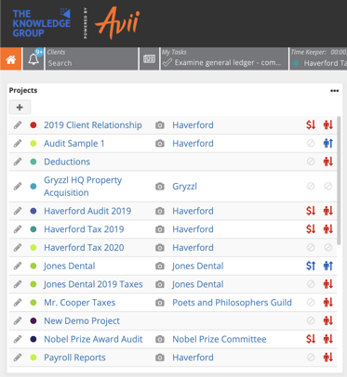
Visit our Insights Library at avii.com
Download the
Software Self-Audit Tool
Request a Free
Software Audit
Try Avii Workspace
Free for Analysis & Trial
DOWNLOAD
APPLY
TRY FREE
Notes:
Software Self-Audit Tool
https://accounting.avii.com/accounting-software-audit-calculator
Software Audit
https://accounting.avii.com/plummeting-accounting-productivity-assessment
Free Trial
https://www.avii.com/signup

Slide 17
Poll #4
Would you like to receive free educational resources or discuss one or more of the solution tool kits with us?
Notes:
Yes
No

